Slide 1

Loan Database for
Notes:
State your consultant/client scenario
Show a sample of the original data
Overview and brief explanation of normalization plan
Brief explanation of the ETL process
Process of interacting with data (analytical procedures):
Why? What are the customer needs that you designed for? What are the insights that your customer is expected to benefit from with the new relational database and relevant tools that you build for them?
How? Did you build custom tools? (raw SQL, Python, R, Metabase, other)
Very brief demo of database interaction (SQL and Metabase)

Slide 2

Problem Statement
Proposal
Normalization Plan
ETL Process
Analytical Procedures
Database Interactions
In today’s presentation...
Problem Description
Lending Club has a lot of archived, unstructured data that need to be organized for easy access and analysis：
Raw dataset: we used is a reduced sample set that contains 5,000 records of loans issued through the 2008-2018, and 97 attributes covering different information such as current loan status, loan owner demographic information, customer financial credit history, payments, collections, secondary applicants, etc.
This dataset contains redundant copies of information in many places:
Example:
member_id ---> employee title, employee length, home ownership, income
zipcode (first three numbers) <--> address_state c
credit_grade/sub_grade ----> interest rate issued to each member
A peer to peer lending company, in which investors provide funds for potential loan borrowers and investors earn a profit depending on the risk they take. Lending Club provides the "bridge" between investors and borrowers.
Notes:
About the original dataset: redundancy: repeated information stored, which will cause data inconsistency
increased consistency. Information is stored in one place and one place only, reducing the possibility of inconsistent data.

Slide 3
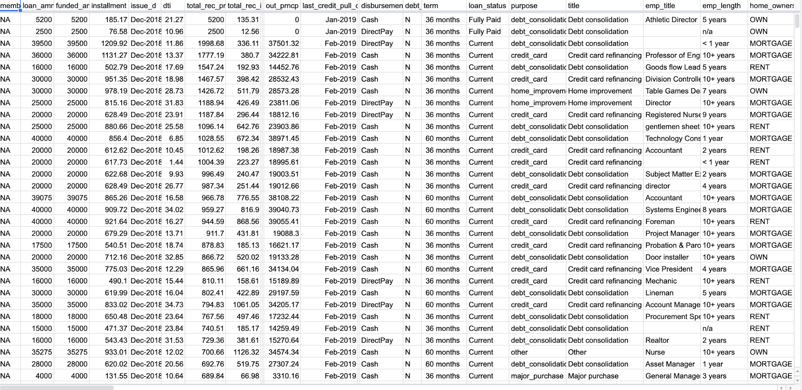

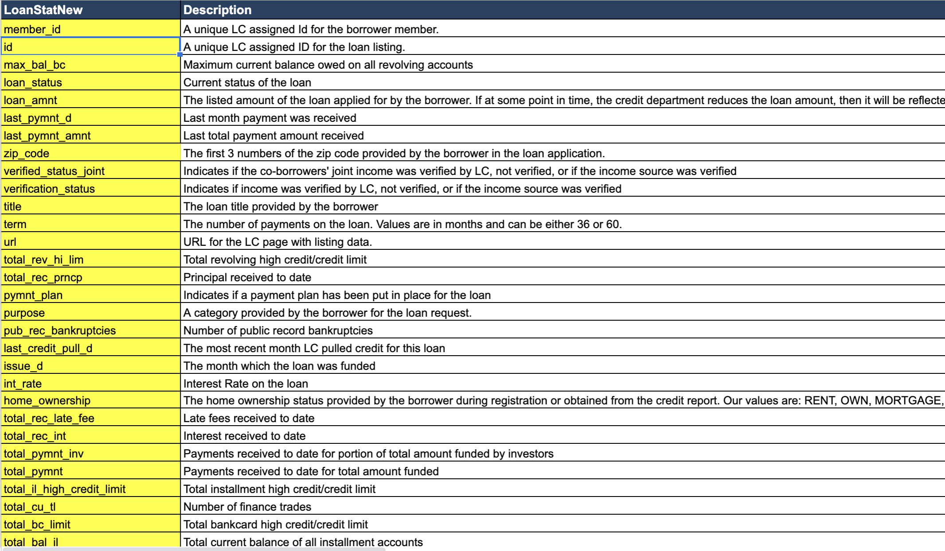
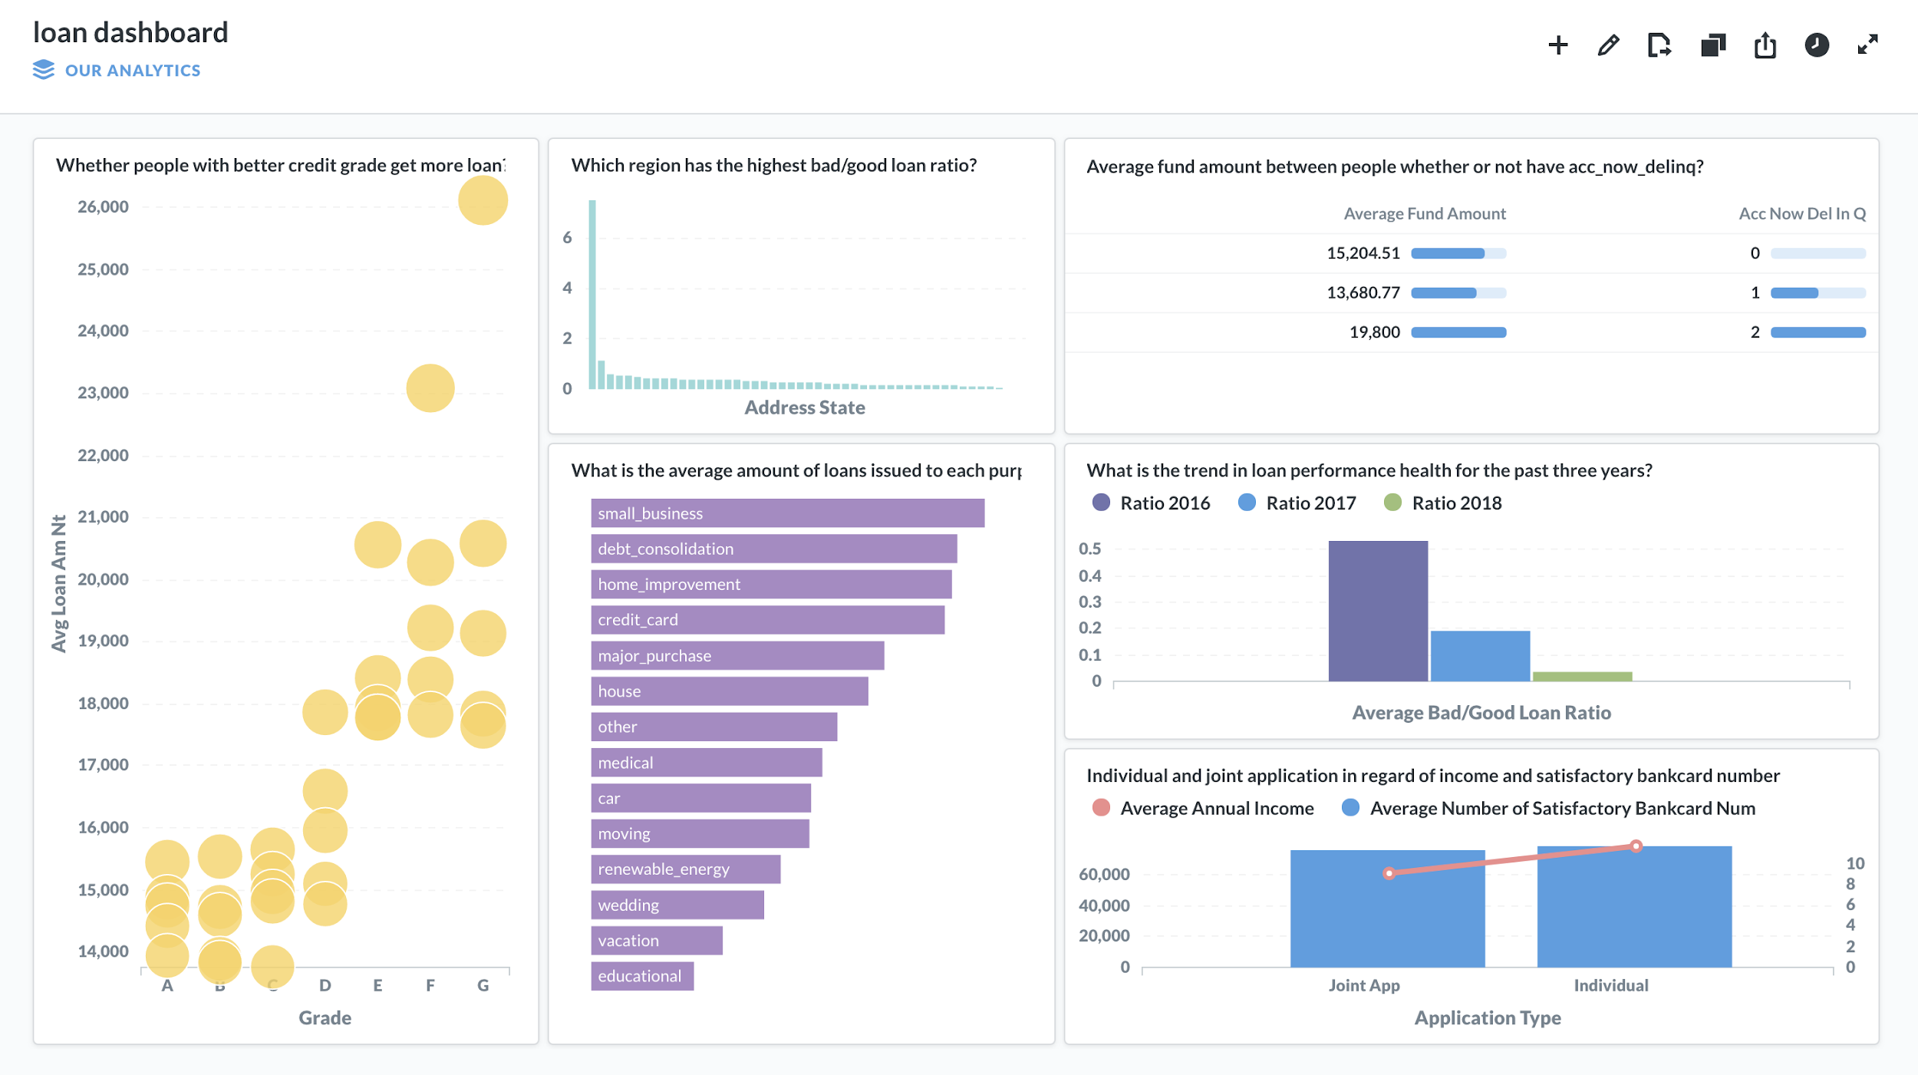
Data Sample
PROPOSAL
Loan Relational DBMS
Reduce redundancy with reorganized independent tables
Achieve data consistency through PK/FK, constraints
Enable triggers to enforce business rules that automatically perform an action after a change is made to database: such to ensure each member inserted into the database fall into A,B,C,D,E,F,G categories of credit
Support simple structured query for daily operations
facilitate business decision making
Attribute Dictionary
2. Interactive Dashboards - Metabase
Current Business Analysis
Customer Analysis
Risk Analysis

Slide 4
Normalization
1NF：include each table cell should contain a single value and each record needs to be unique
2NF：no non-prime attribute is dependent on the proper subset of any candidate key of table
3NF：to has no transitive functional dependencies
Loan dataset
1NF
customer-related
account_related
2NF
Personal information based
Credit status based
loan-related
payment-related
3NF
terms_info, statuses_info, loans_purpose, collections, applications, payments_info, ppymts_schedule, secondary_applicants, interest_rates, addresses, inquires, customer_credit_histories, accounts_info, customers, bankcards, loans_info

Slide 5
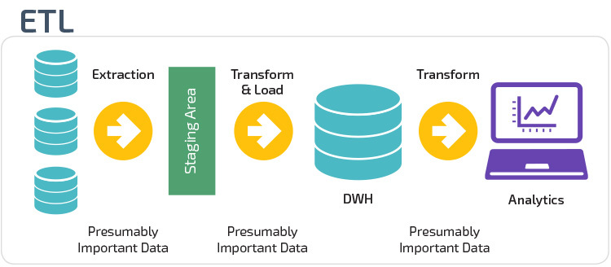
ETL Process
Extract, Transform and Load.
Moving the data into a data warehouse.
In the extraction step, data is extracted from the source system into the staging area.
In the transformation step, the data extracted from source is cleansed and transformed .
In the loading data step, data is loaded into the warehouse .

Slide 6
Process of Interacting
Who
Data Analyst
Manager / C-Executive
Process:
1. Access & modify database
2. Update database
3. Write and execute SQL code get insight from database
Process:
1. High-level overview through visualizations
2. Interact with data using dashboards and get insight automatically
How
Python/R
based on RD
How
Metabase
Goal:
Day-to-day operational analysis
Goal:
Make business decision
Structure archived raw data to build analysis for better business operation and decision

Slide 7
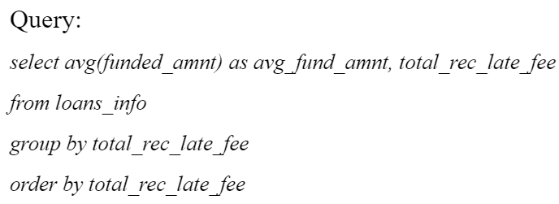
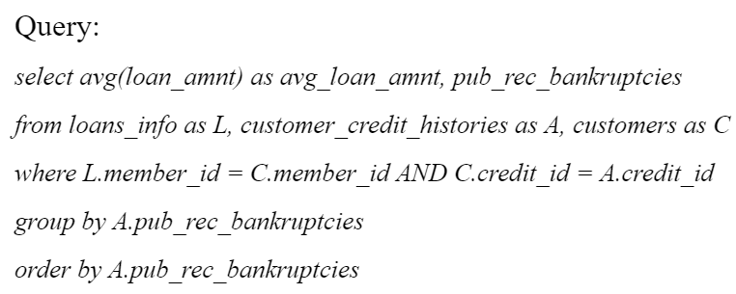
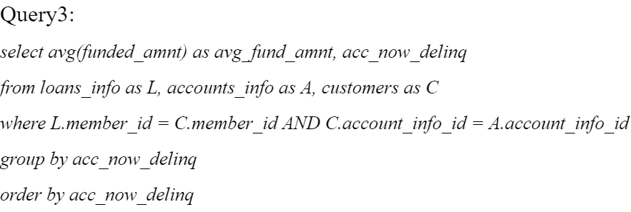
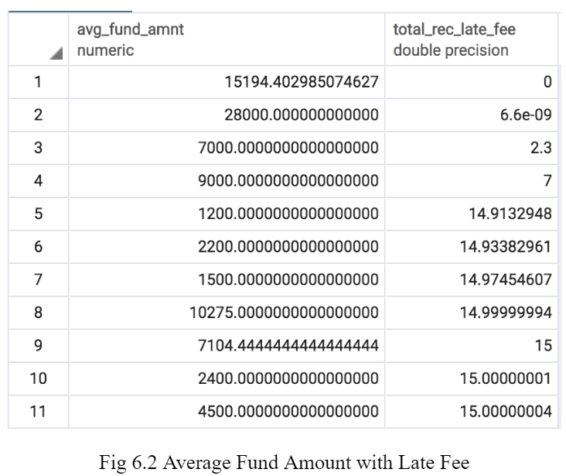
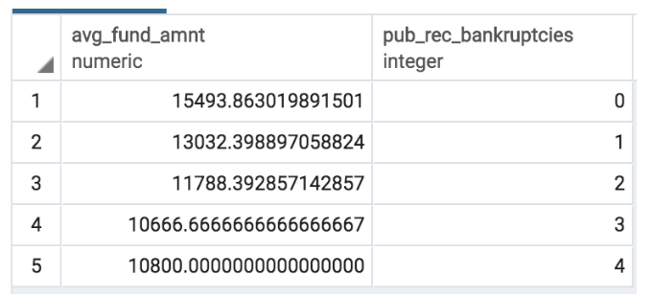
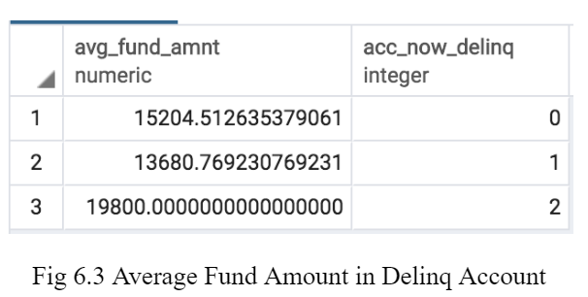
Database Interaction with SQL : A DEMO
Is there a pattern for customers’ credit history and funded loan amount?
Is there a difference between fund amount and customers with different count of public record of bankruptcy?
Is there a difference among fund amount and customers who have higher late fee and who have lower?
Is there a difference among fund amount and whether or not a customer has acc_now_delinq?
Summary:It is not likely that people with less acc_now_delinq to receive more average fund amount.
It is not likely that people with less late fee to receive more average amount.
People with more public record bankruptcies tend to receive less average fund amount

Slide 8
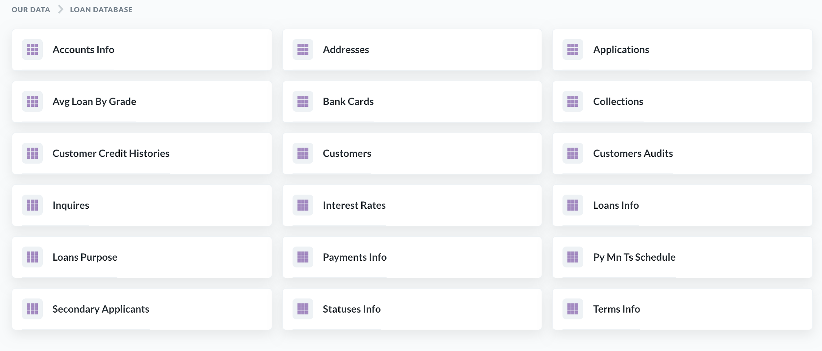
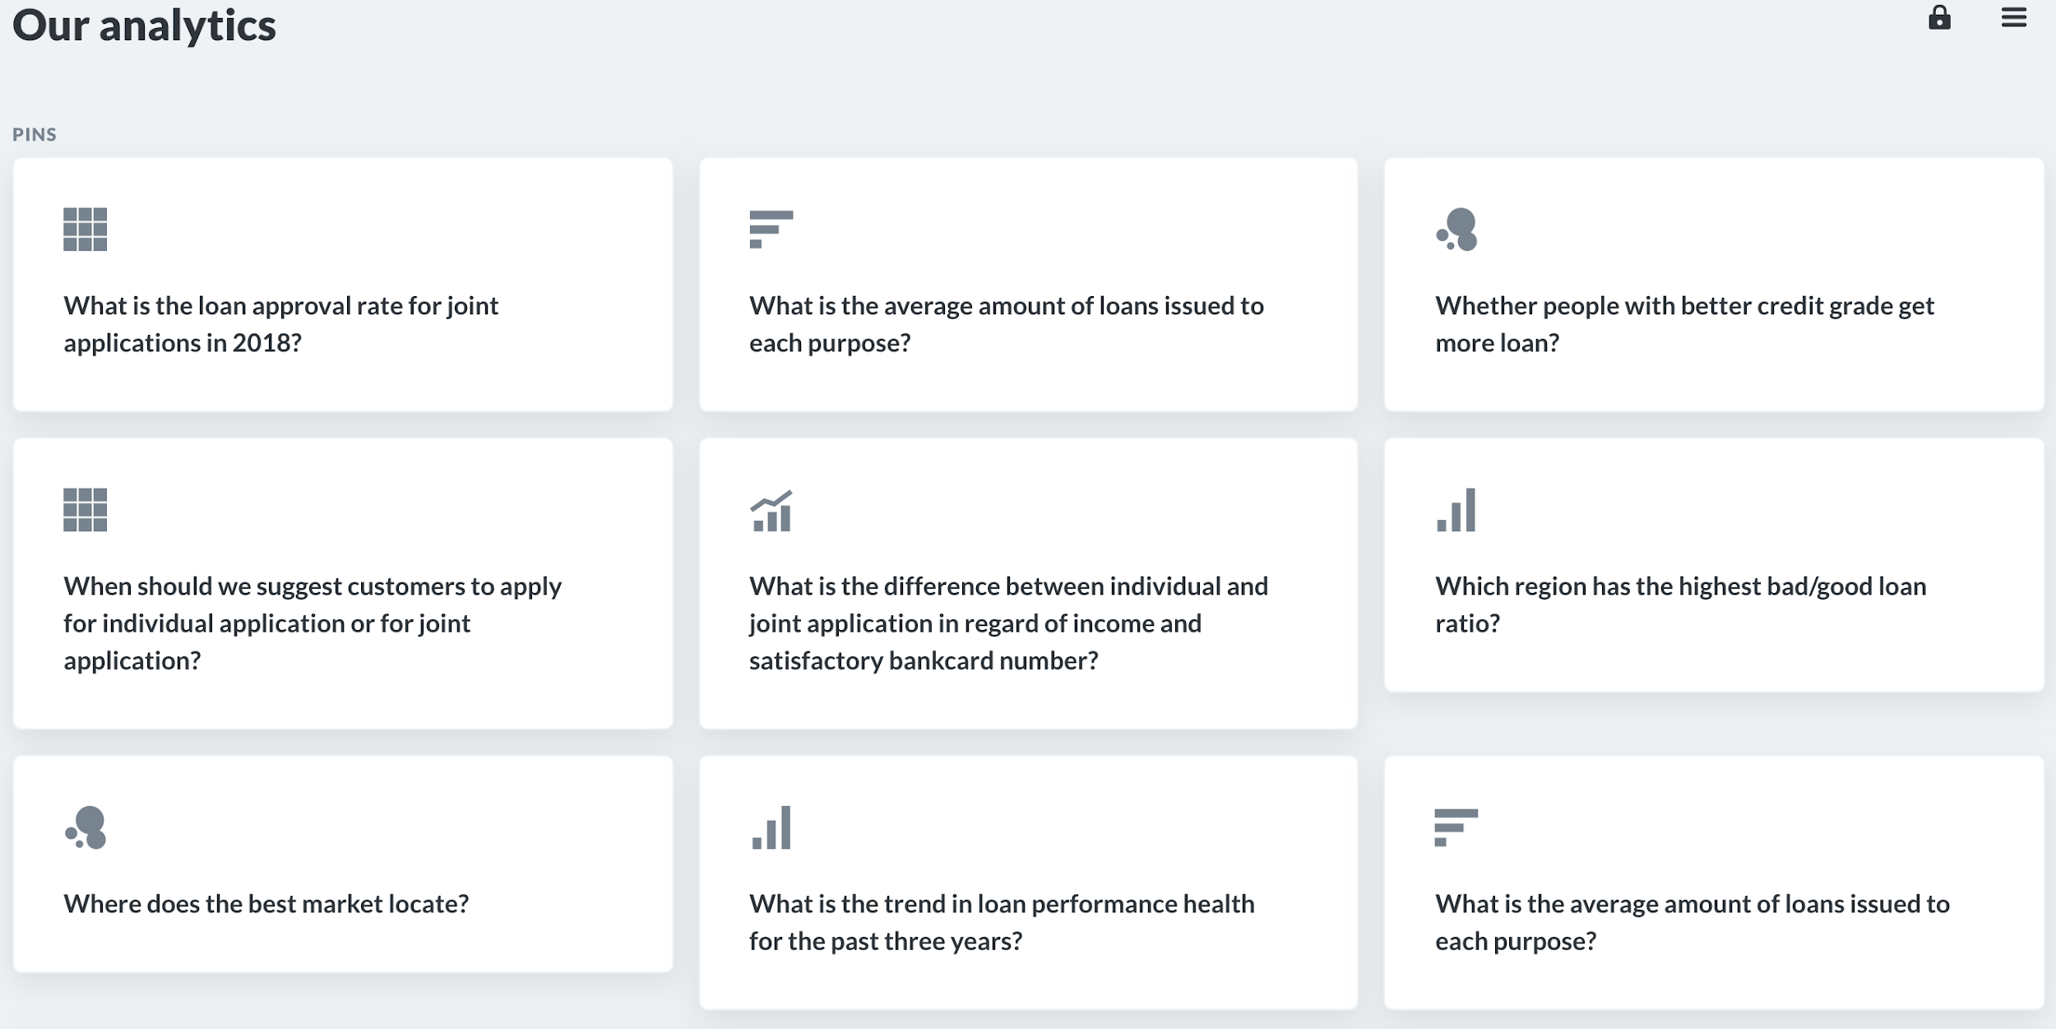
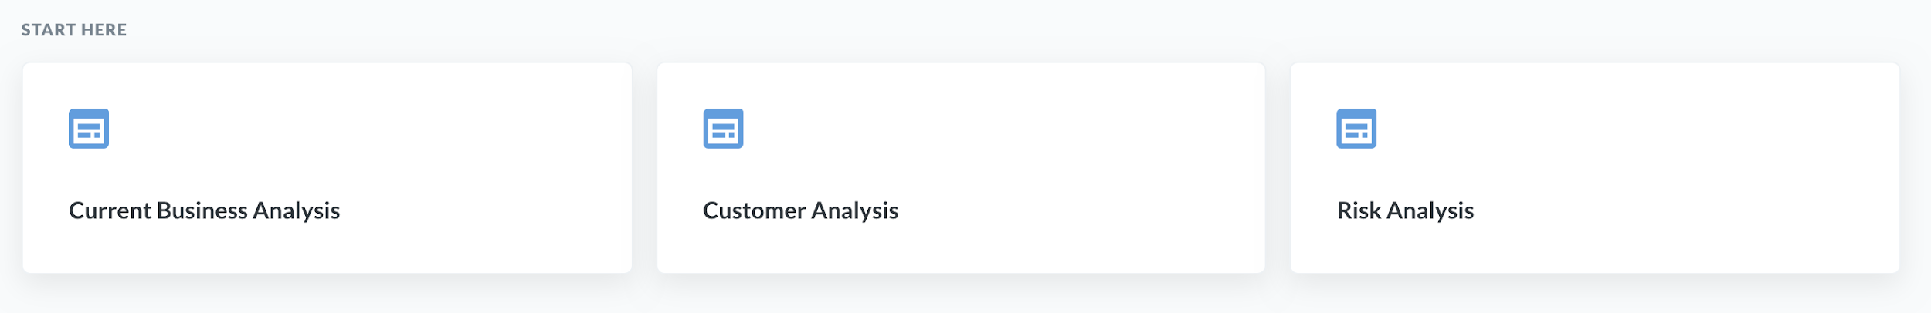
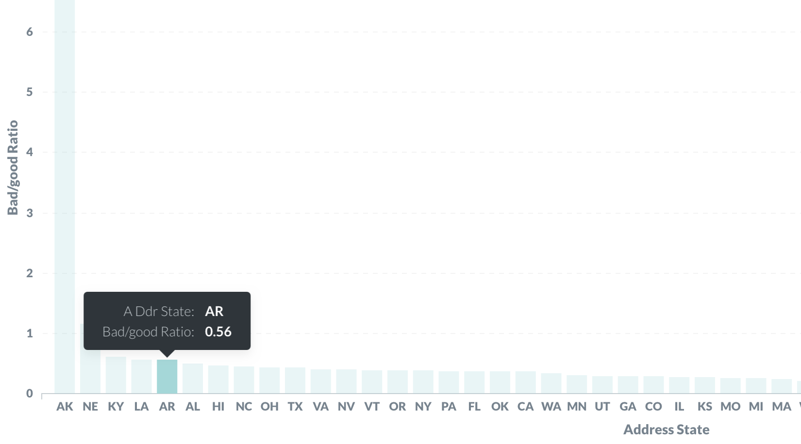
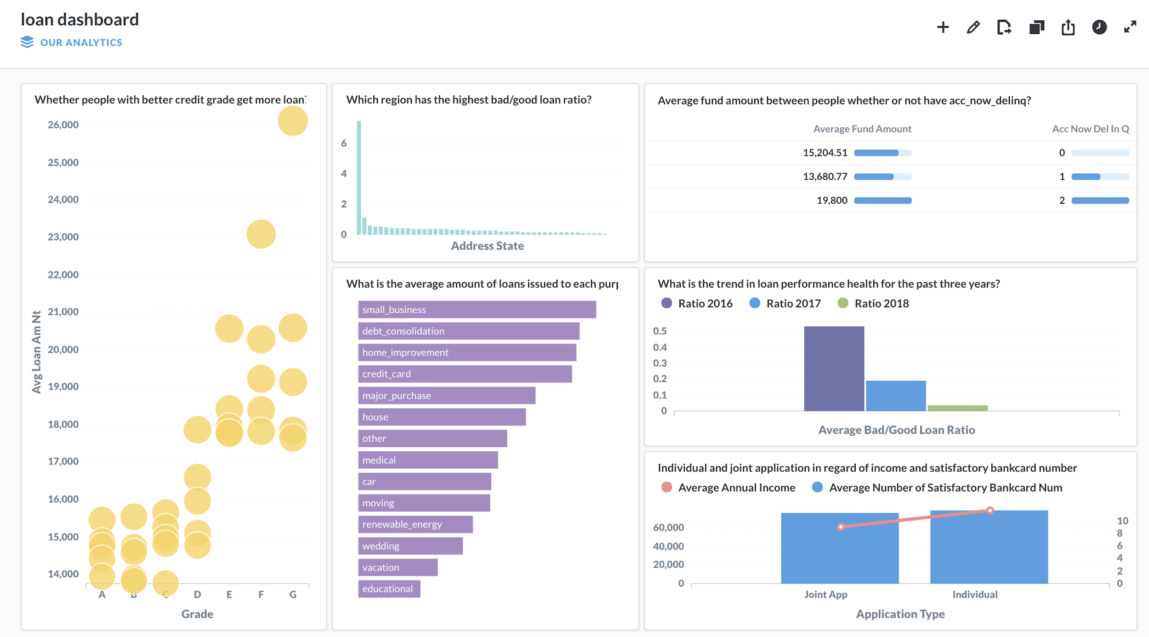
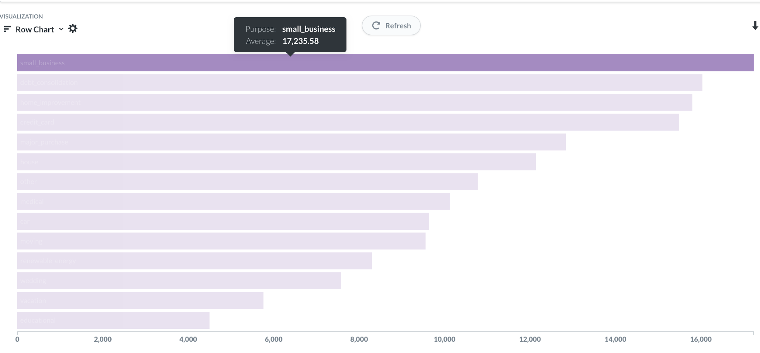
Database Interaction with Metabase: A DEMO

Slide 9
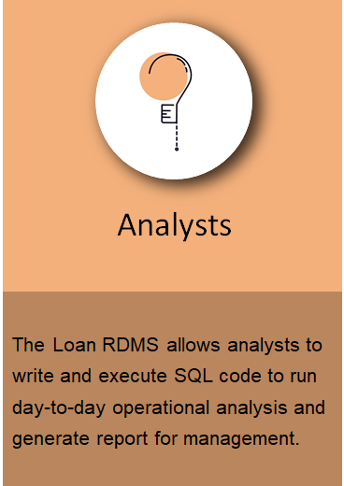
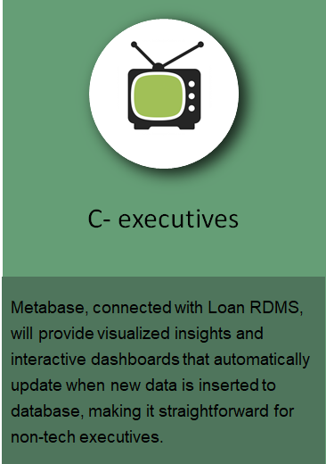
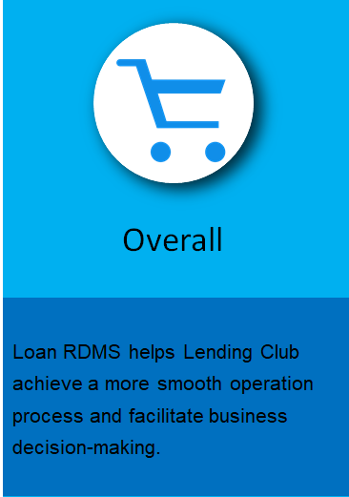



Conclusion: How will Loan RDMS benefit Lending Club?

